Slide 1
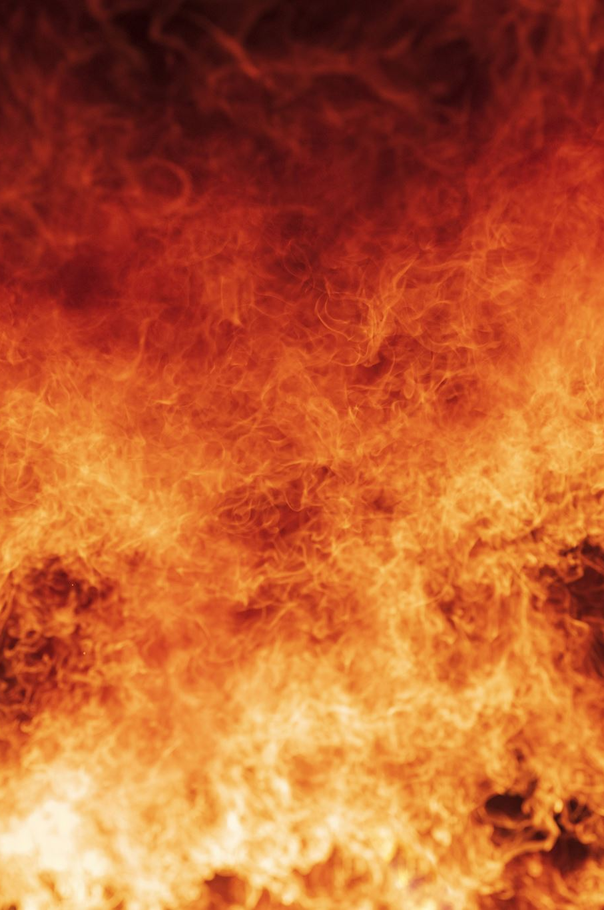
Nasa’s Near real-time Active Fire data
Spatial Temporal Final Project
Zeynep Cetin & Katrina Altawil

Slide 2
Fire dataset
Near real-time active fire data
Organization: NASA Fire Information for Resource Management System
Collected using Moderate Resolution Imaging Spectroradiometer (MODIS) instrument on the Aqua and Terra satellites
MODIS measures the variable of interest, brightness of fire, in Kelvins
14 variables including coordinates, day, and brightness, 83,490 observations
United States in 2023 (spatial-temporal analysis on August 1-8)
Notes:
Zey

Slide 3
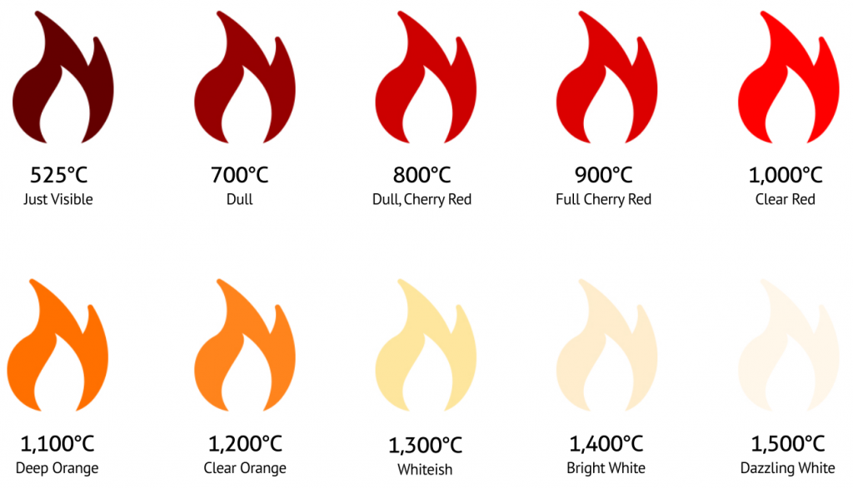
Kelvin scale for brightness
Kelvin = °C + 273.15
Boiling point of water is 100°C = 212°F = 373.15 K
Range of brightness is 0 to 508.9 Kelvin
Interpreted based on the radiation measured by the sensor in the specific channel (not actual fire temperature itself)
Notes:
Kat

Slide 4
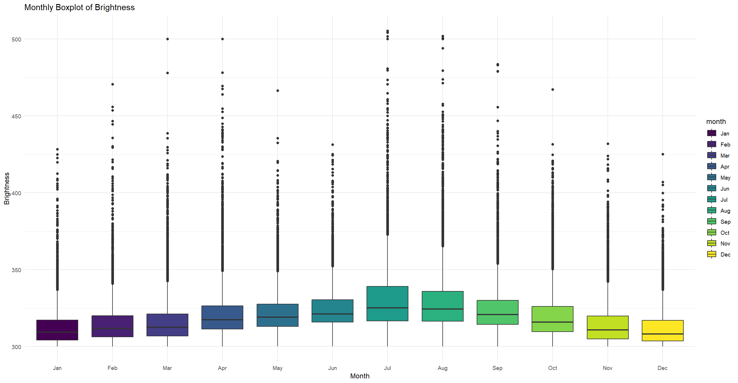
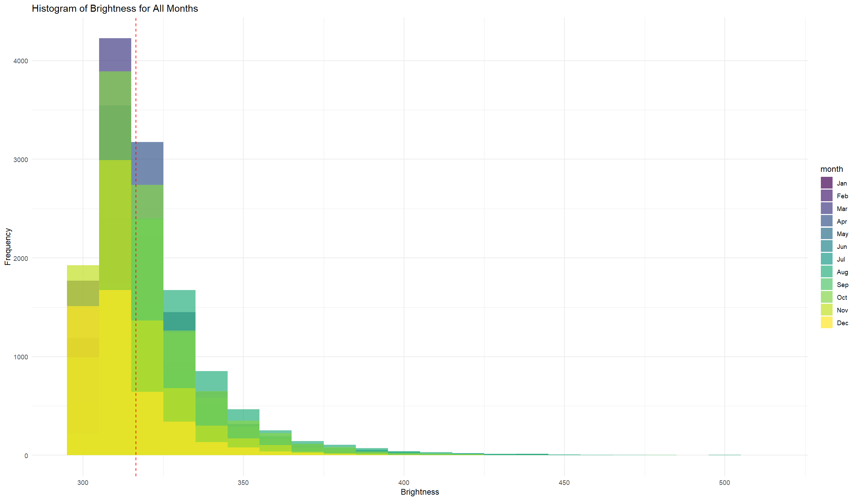
Challenges
1) Brightness distribution is right-skewed (many outliers)
Solution: Eliminate brightness > 350 Kelvin
Notes:
Zey

Slide 5
Challenges
2) Large data set (long processing time)
Solution: Include only August
3) Large grid with empty space that includes the Pacific Ocean
Solution: Include only continental U.S., i.e., exclude Alaska and Hawaii
Notes:
Zey

Slide 6
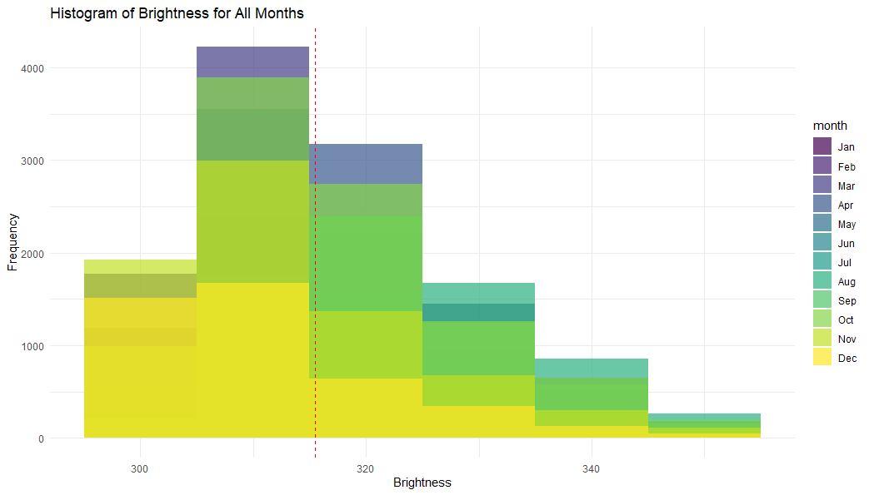
descriptive analysis of dataset
We can see that fires were more frequent and intense during spring & summer months.
The mean brightness for the entire year is 317.4 Kelvin, meanwhile the mean brightness for the month of August is 323.42 Kelvin.
The standard deviation for the year is 11.23 vs. 10.93 for the month of August.
Notes:
Zey

Slide 7
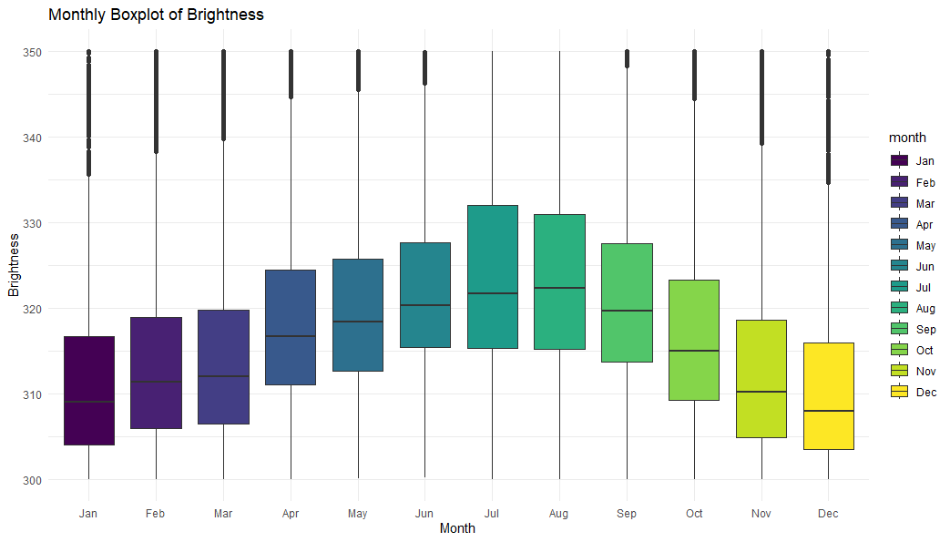
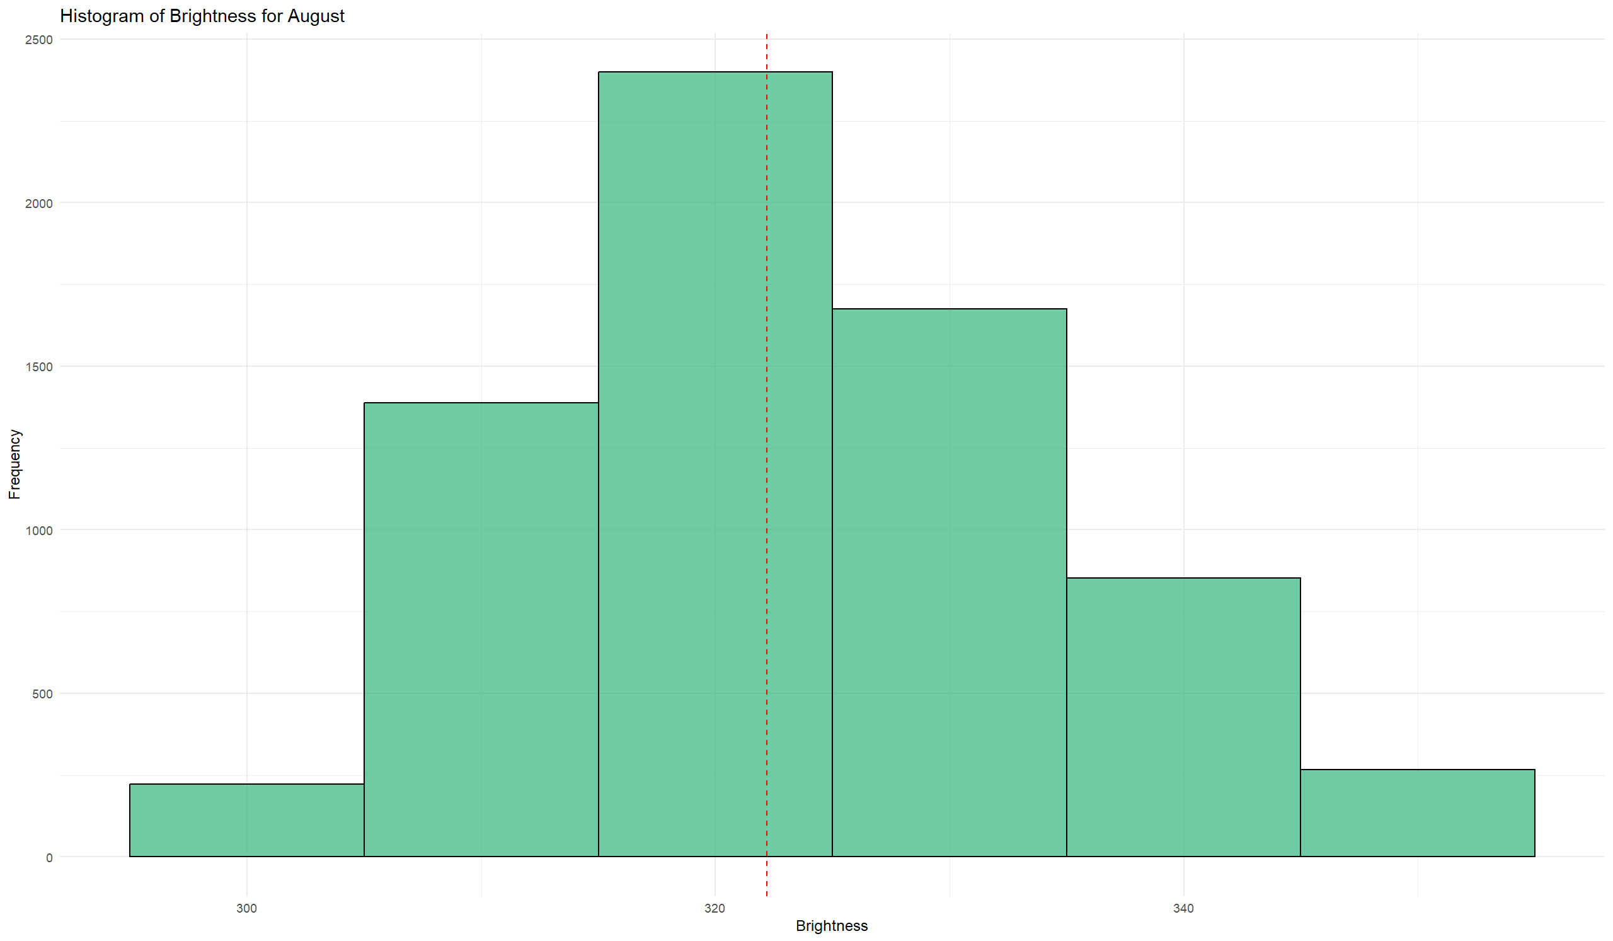
Distribution of brightness
Over the year
august
Notes:
Zeynep

Slide 8

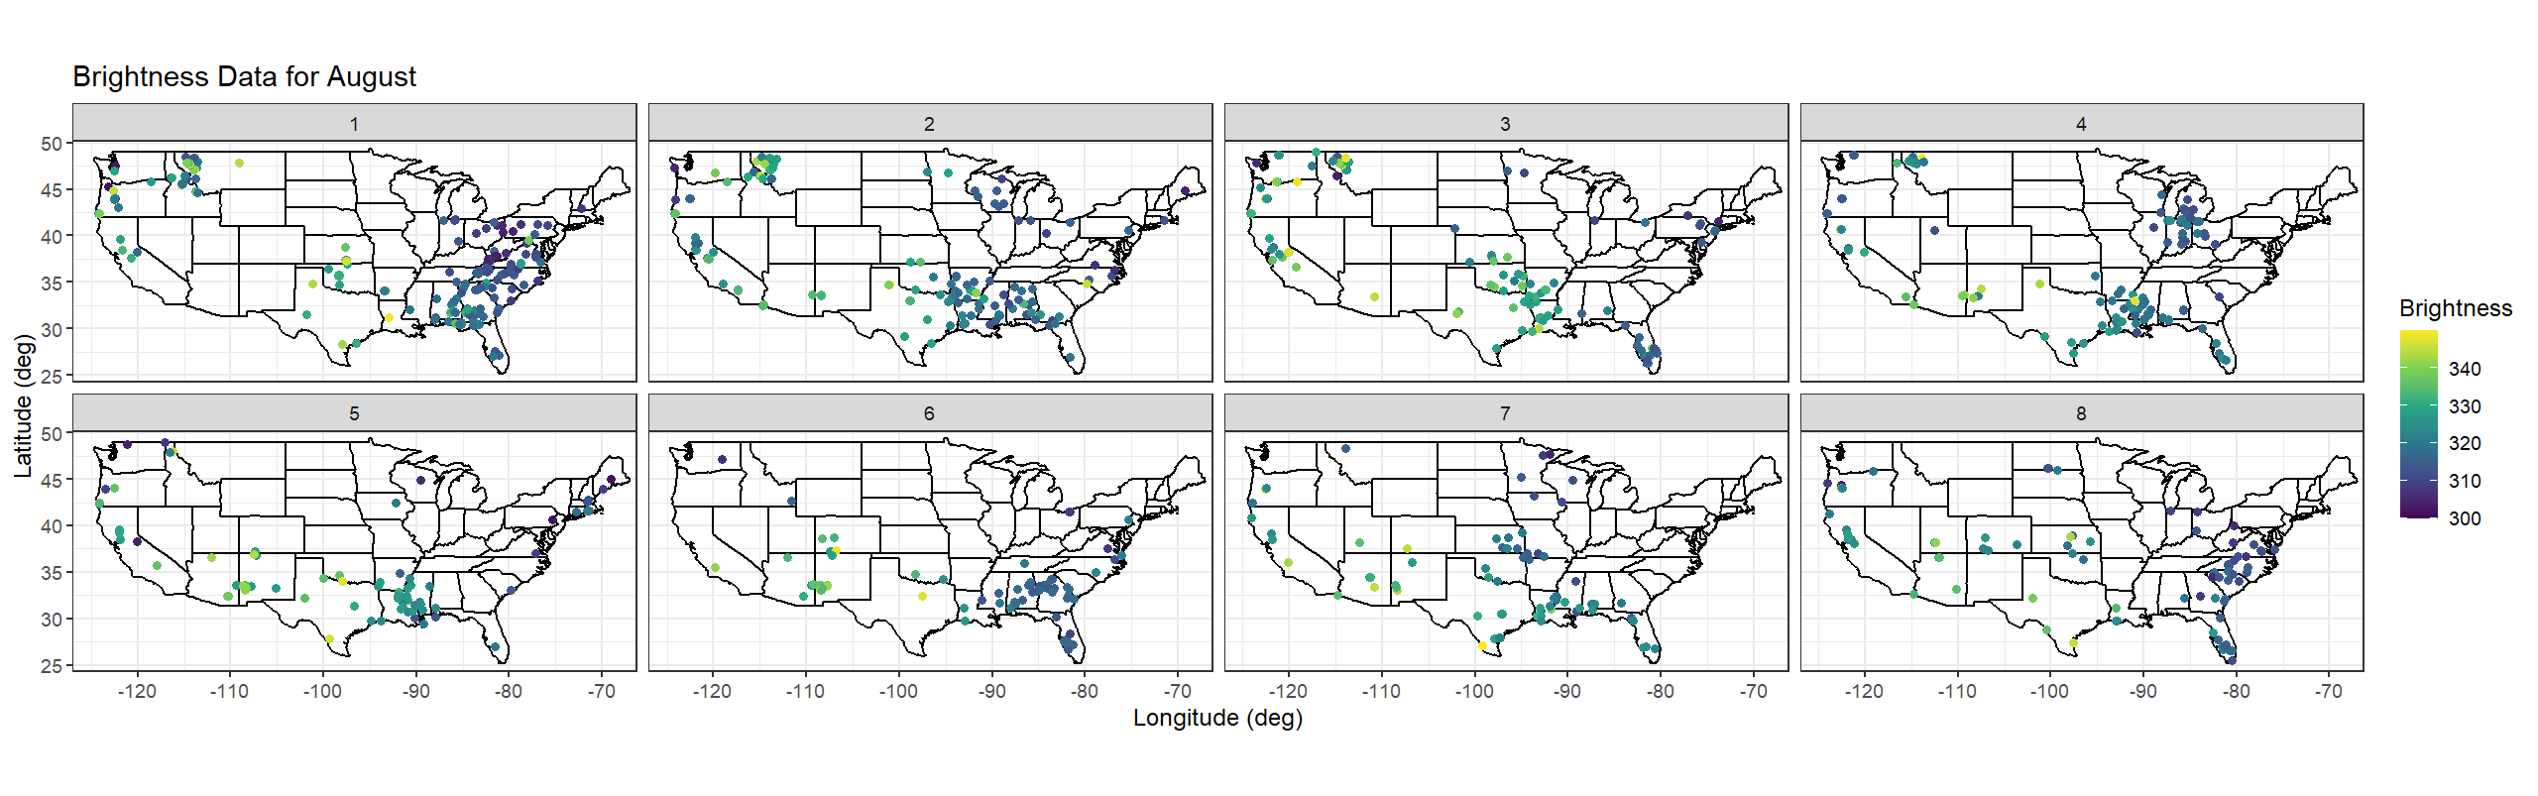
SPATIAL-TEMPORAL PLOT
Notes:
Katrina

Slide 9
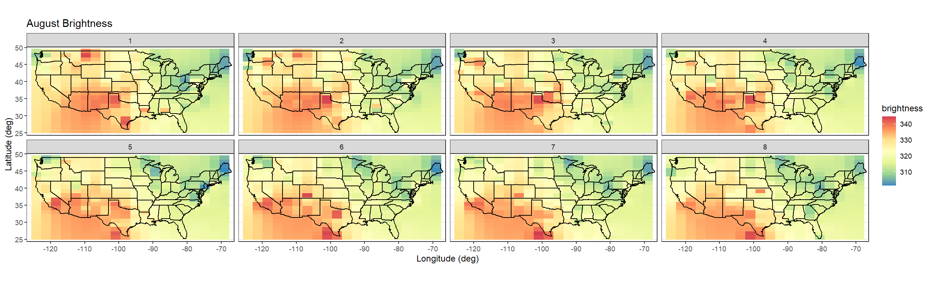
PREDICTION GRID AND IDW INTERPOLATION
The prediction grid accounts for regions both with and without data points. Areas that originally had data points, particularly those with brighter fires (e.g., the Southwest region of the United States), were predicted to have higher brightness values in the interpolated grid.
Notes:
Zeynep

Slide 10
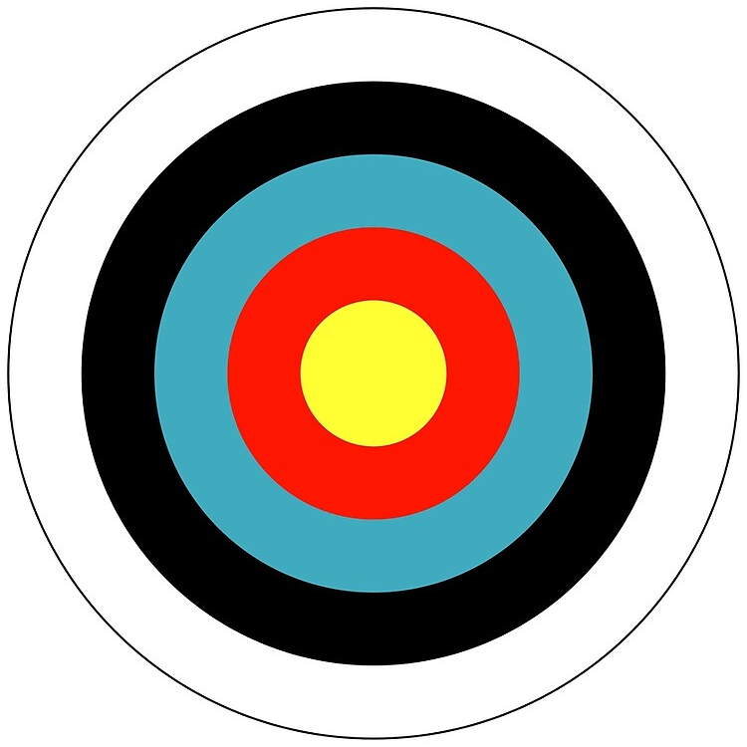
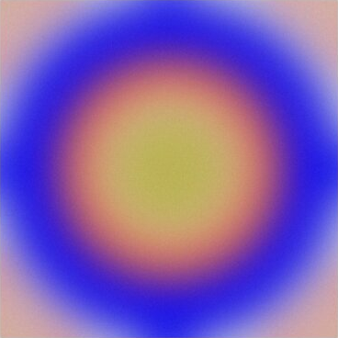
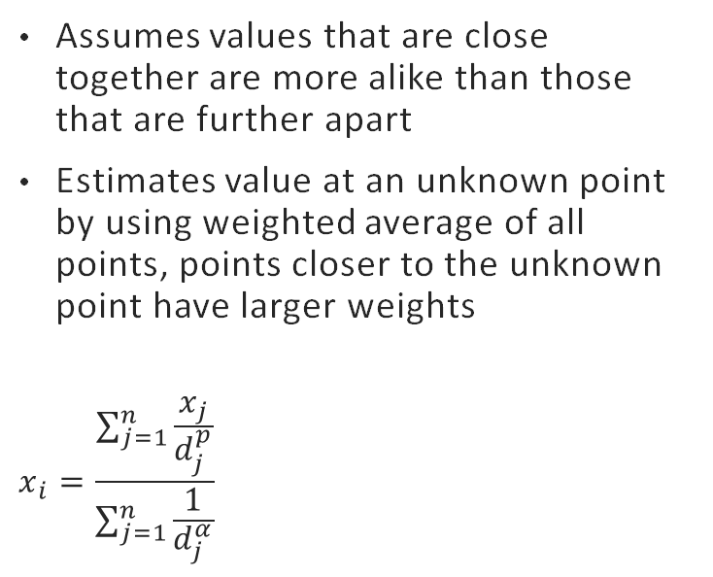
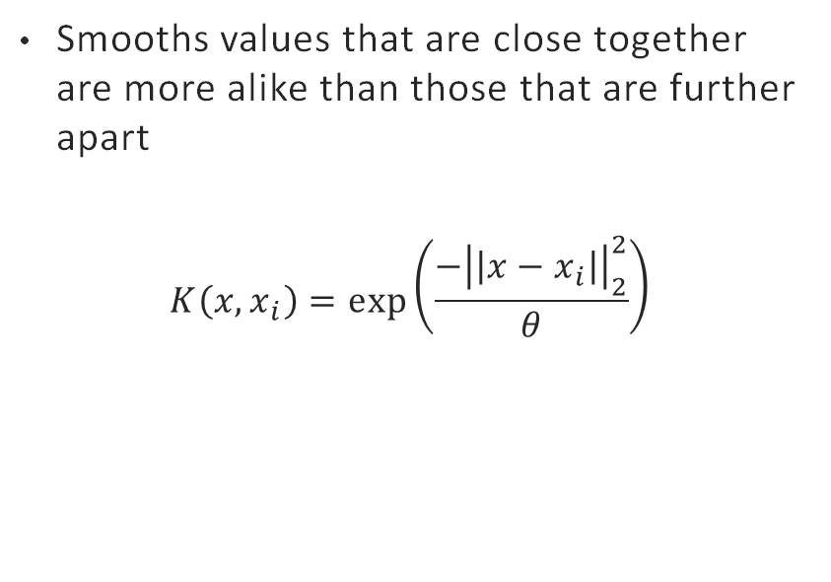
Interpolation techniques
Inverse distance weighting (idw)
Gaussian kernel
Assumes values that are close together are more alike than those that are further apart
Estimates value at an unknown point by using weighted average of all points, points closer to the unknown point have larger weights
$$x_{i}=\frac{\sum_{j=1}^{n}{\frac{x_{j}}{d_{j}^{p}}}}{\sum_{j=1}^{n}{\frac{1}{d_{j}^{α}}}}$$
Smooths values that are close together are more alike than those that are further apart
$$K\left(x, x_{i}\right)=\exp\left(\frac{−{\left|\left|x−x_{i}\right|\right|}_{2}^{2}}{θ}\right)$$
Notes:
Katrina

Slide 11
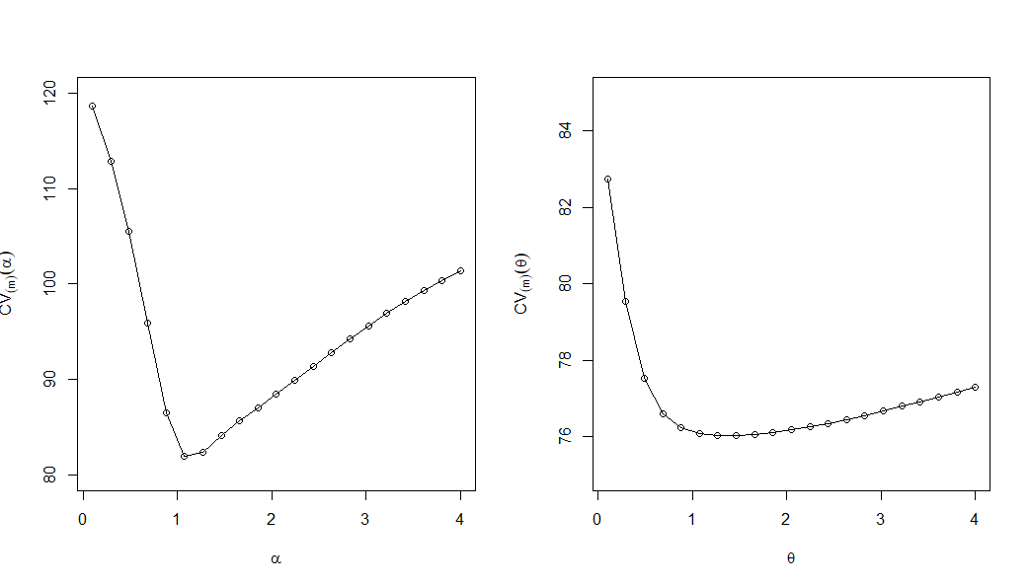
Leave-One-Out Cross-Validation (LOOCV)
IDW
Gaussian
For each observation:
Temporarily remove it from the dataset.
Use the remaining data to predict its value using the chosen method (IDW or Gaussian).
Calculate the mean squared error (MSE) for the prediction.
Both methods show a clear optimal parameter value that minimizes the LOOCV error.
Notes:
Zeynep
IDW = Inverse distance weighing.

Slide 12
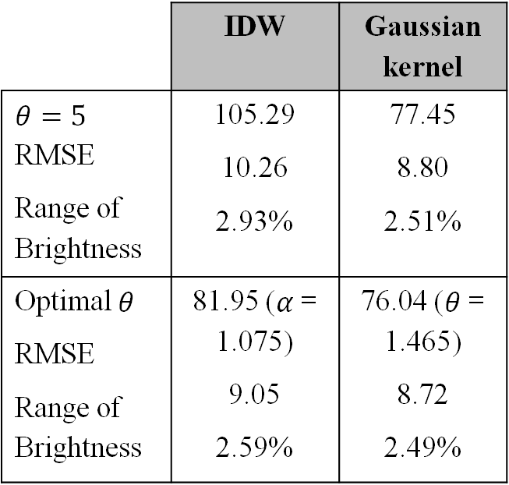
Loocv scores
 | IDW | Gaussian kernel
$$θ=5$$ RMSE Range of Brightness | 105.29 10.26 2.93% | 77.45 8.80 2.51%
Optimal $θ$ RMSE Range of Brightness | 81.95 ($α$= 1.075) 9.05 2.59% | 76.04 ($θ$ = 1.465) 8.72 2.49%
Root MSE (RMSE) are in same units as brightness (K)
On average, predictions deviate about (RMSE) from actual value.
Range of brightness is calculated by RMSE / (350-0) K * 100%
Gaussian kernel has lower LOOCV
Smaller prediction errors on average
Gaussian kernel has higher optimal parameter value
Considers weight on points further away from interpolated point
Notes:
Katrina

Slide 13
CONCLUSION / DISCUSSION
The interpolated prediction grid captured the spatial distribution of fire brightness effectively.
The analysis revealed that brightness was higher in the Southwest region, which aligns with the observed fire activity patterns.
The Gaussian kernel interpolation method outperformed IDW with a lower LOOCV RMSE.
Considerations/Explanatory factors:
Climate (humidity vs. desert)
Location (mountains vs. prairie vs. marshes)
Brightness limit (350 K)
Exclusion of Alaska and Hawaii
Notes:
Zeynep

Slide 14
References
GISGeography. “Inverse Distance Weighting (IDW) Interpolation.” GIS Geography, 22 May 2016, gisgeography.com/inverse-distance-weighting-idw-interpolation/. ​
James, Gareth, et al. An Introduction to Statistical Learning: With Applications in R. Springer, 2013, https://www.statlearning.com/.
NASA. “Active Fire Data Attributes (MODIS and VIIRS).” Earthdata, NASA, https://www.earthdata.nasa.gov/data/tools/firms/active-fire-data-attributes-modis-viirs.​
NASA. “FIRMS: Active Fire Data by Country.” Earthdata, NASA, https://firms.modaps.eosdis.nasa.gov/country/.​
Wikle, C. K., Zammit-Mangion, A., and Cressie, N. Spatio-Temporal Statistics with R. Boca Raton, FL: Chapman & Hall/CRC, 2019. https://spacetimewithr.org.
Zhuang, Xiahai, and Yipeng Hu. “Statistical Deformation Model: Theory and Methods.” Elsevier EBooks, 1 Jan. 2017, pp. 33–65, https://doi.org/10.1016/b978-0-12-810493-4.00003-1.

